Slide 1
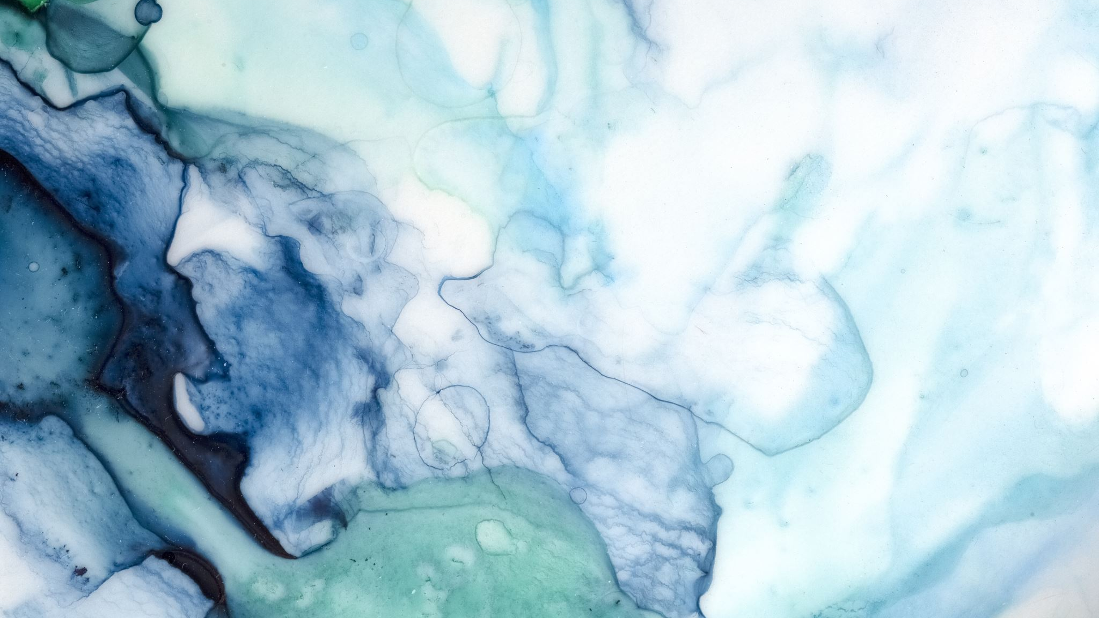
The Cityscapes Dataset for Semantic Urban Scene Understanding
Tommaso Sommaruga
Miro Rava

Slide 2
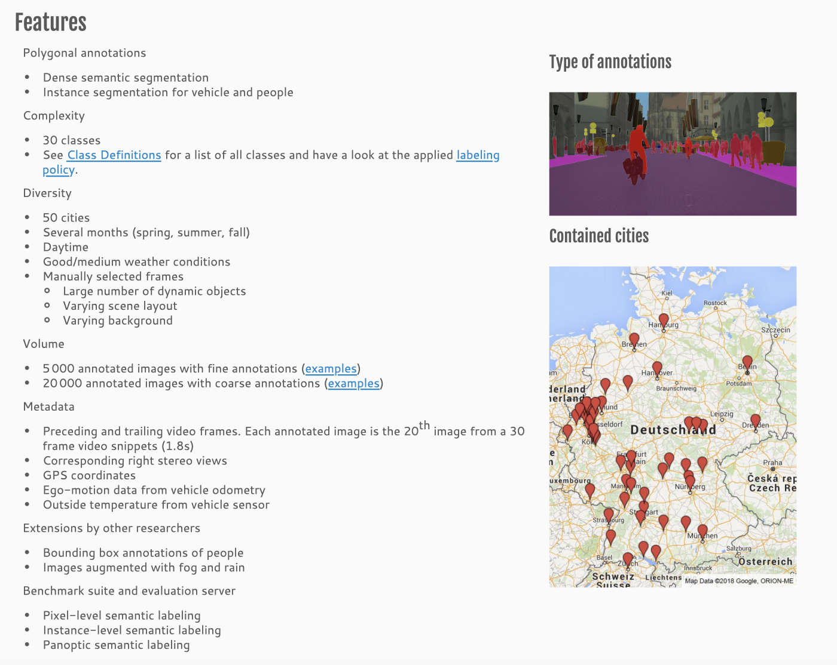
Overview
https://www.cityscapes-dataset.com/dataset-overview/

Slide 3
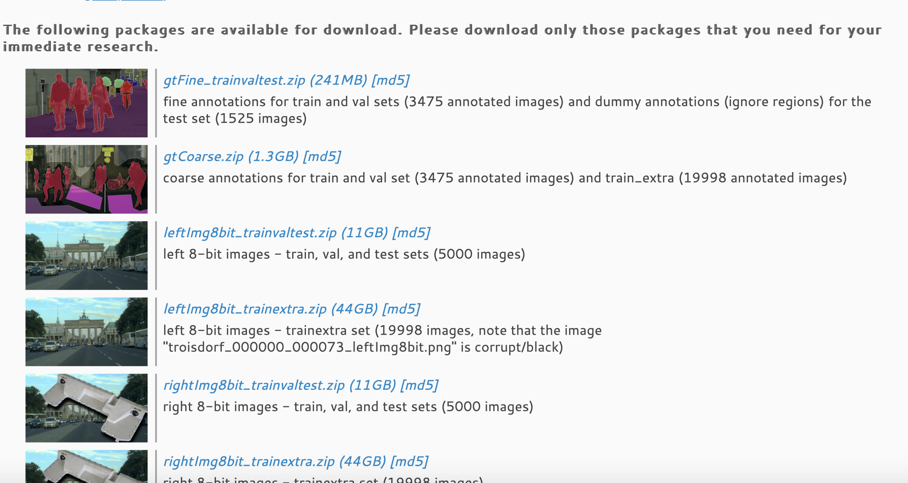

Slide 4
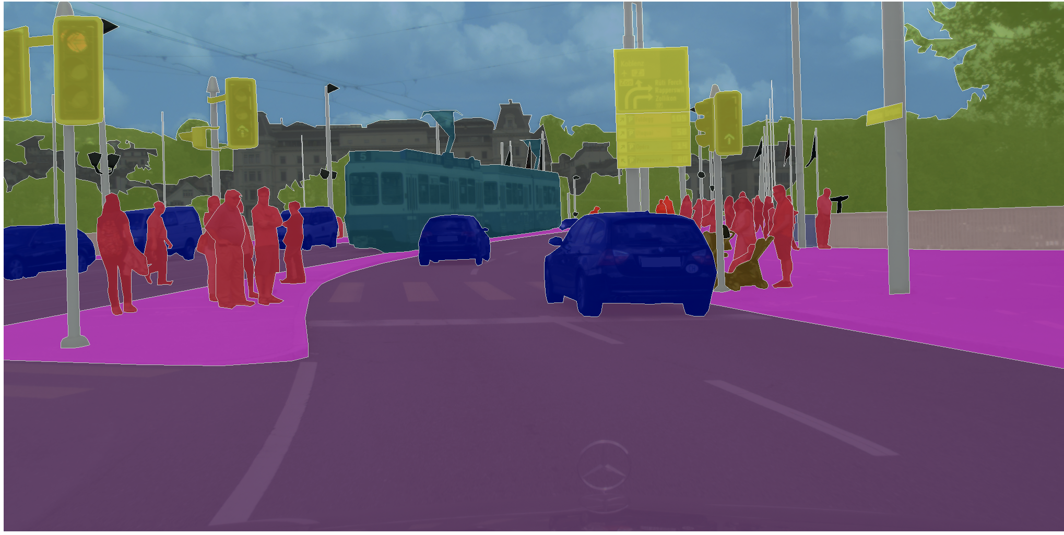

Slide 5
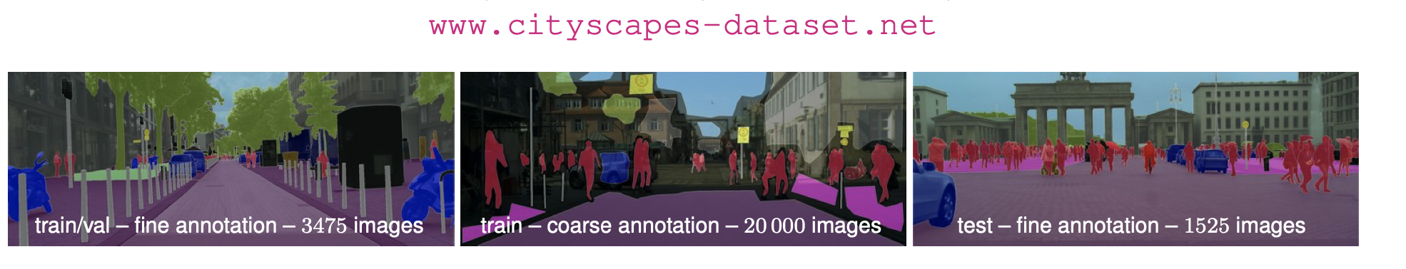
Dataset composition

Slide 6
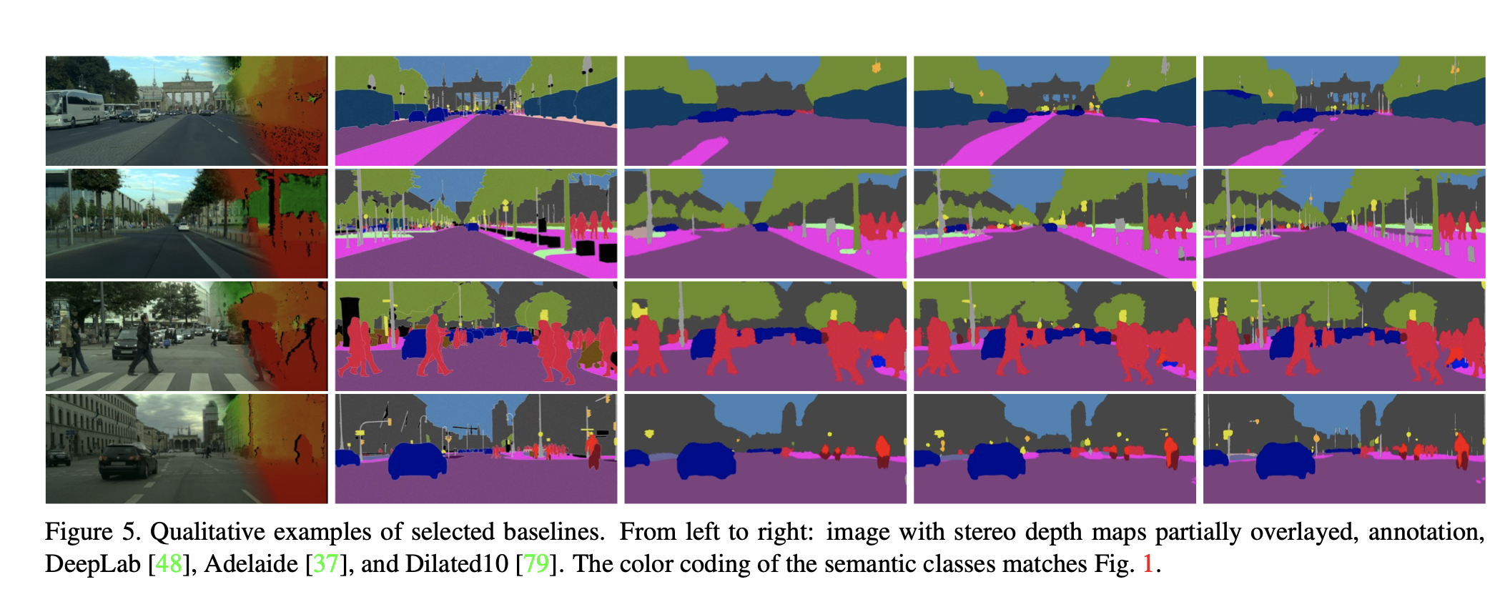
Dataset masks

Slide 7
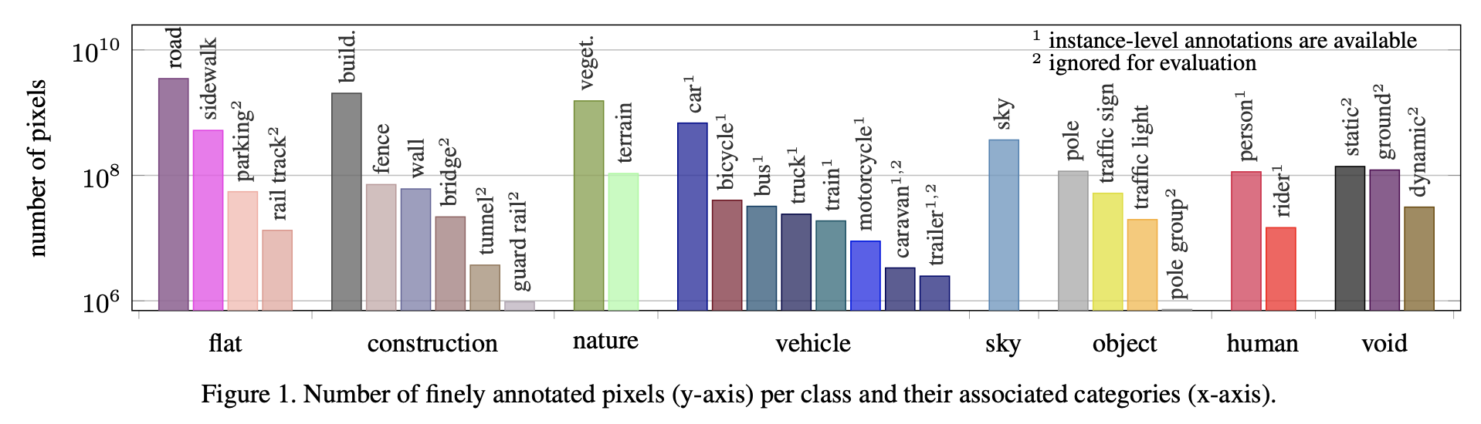
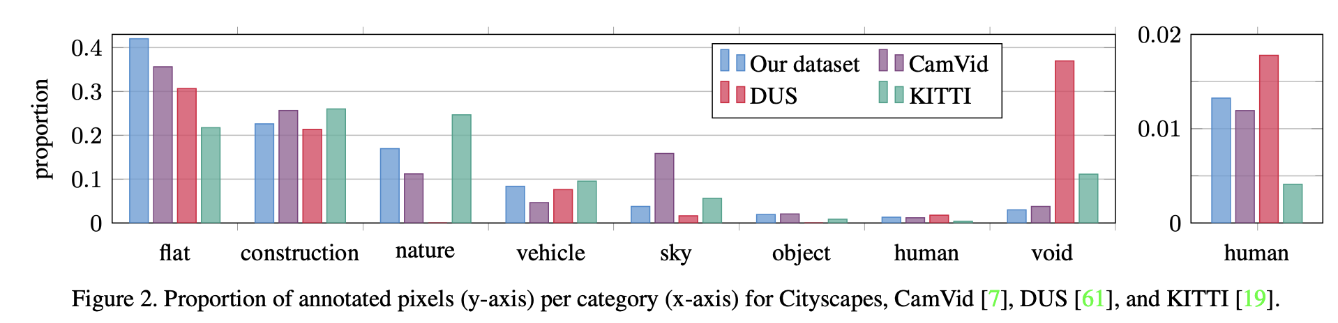
Proportion of objects and pixels

Slide 8
Possible task to be performed
Cityscape segmentation is used in real-world applications, such as autonomous driving, urban planning, and traffic monitoring.
Define the specific categories within "road" and "traffic" (e.g., road surface, lanes, vehicles, traffic lights, pedestrians).
Baseline RGB Classification: Use RGB values of the central pixel to classify road vs. non-road with logistic regression for a simple start.
Patch-Based CNN: Build a small CNN that classifies patches centered on each pixel to improve accuracy by incorporating spatial context.

